Slide 1
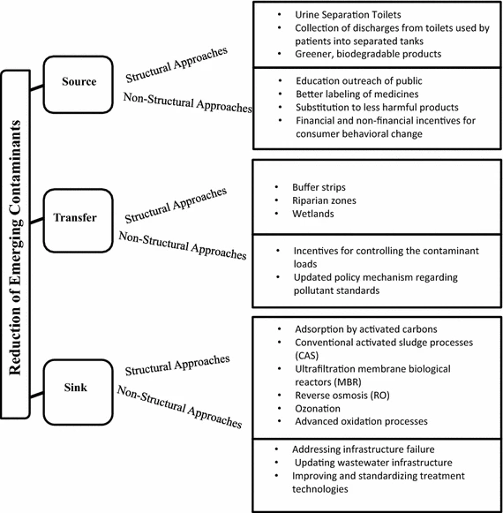
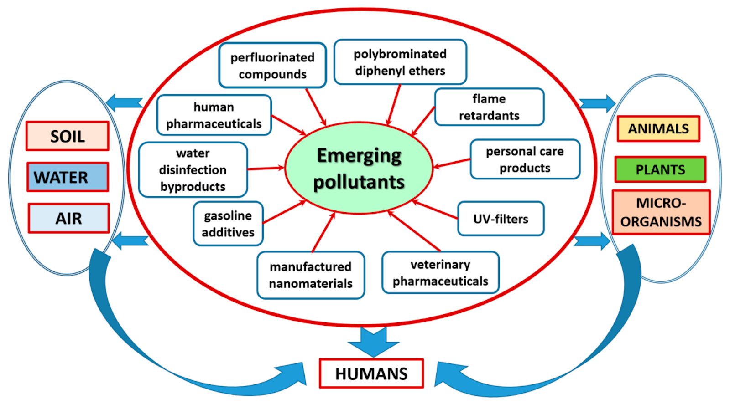
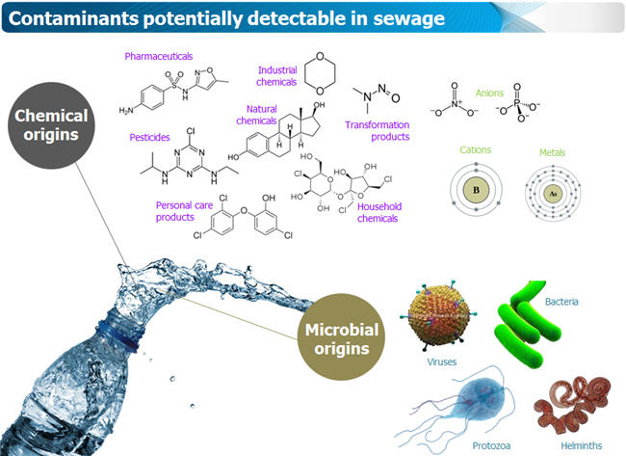
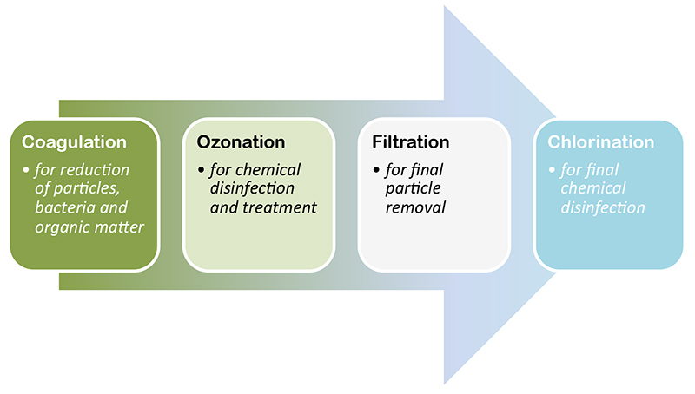
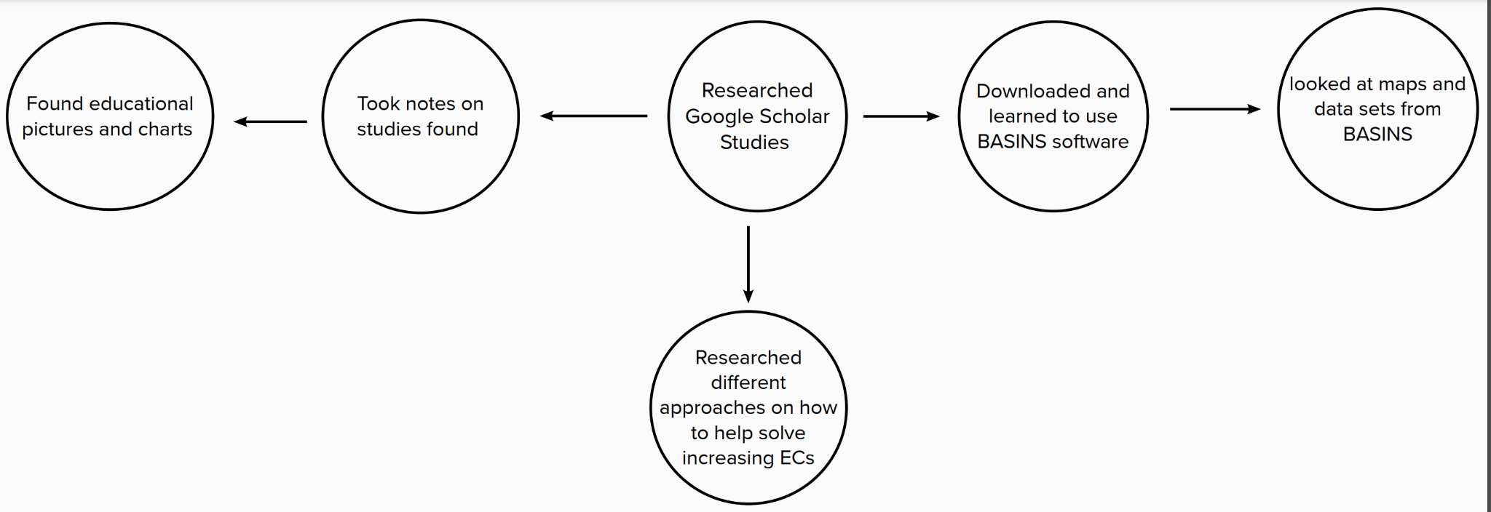
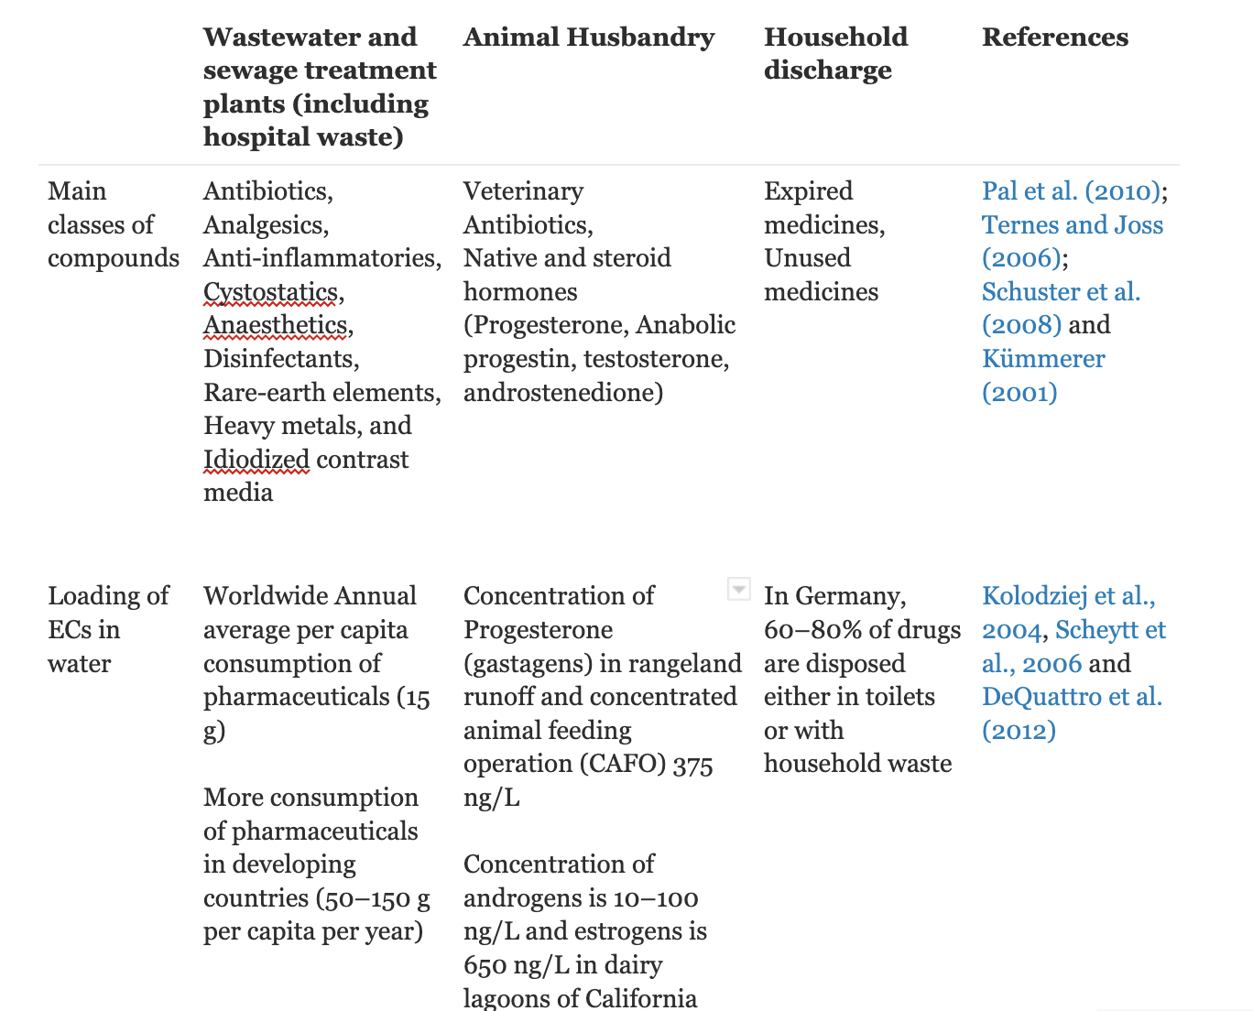
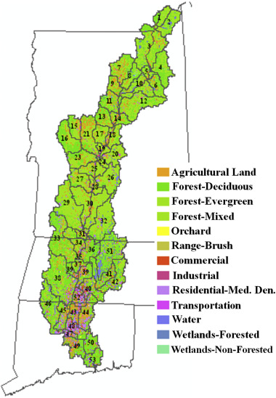
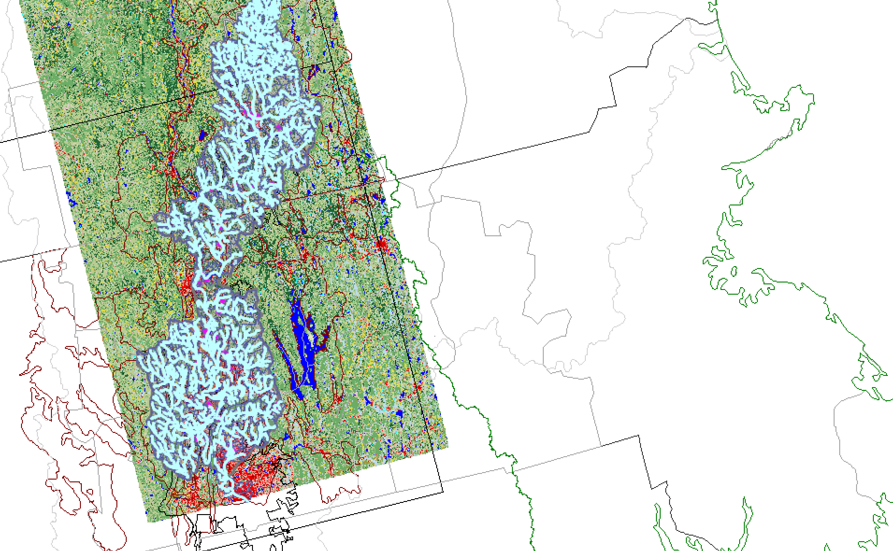
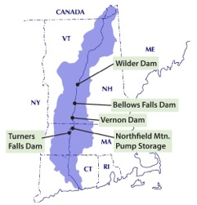
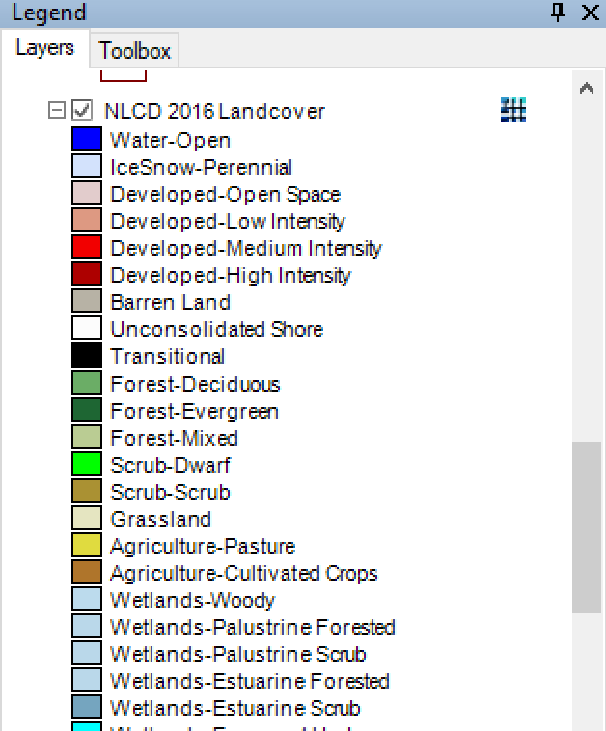
Managing Emerging contaminants in the Connecticut River Watershed
Brianna Carlisle¹, Timothy Randhir²
1. Student, University of Massachusetts Amherst, Amherst, MA
2. Mentor: Professor, University of Massachusetts-Amherst
Introduction
Background
Results/Discussions
Emerging contaminants (ECs) are found in bodies of water all around the world and are very toxic to the environment. ECs are not only toxic to the environment but to human health as well. These substances or compounds are increased from things like pesticides, the pharmaceutical industries, and things such as self care products.They can come from places like hospitals, expired drugs, household discharge, and waste from animal operations. Most importantly, having an increase in concentration of these ECs are affecting the rate of climate change in a negative manner. These ECs can come from point sources or nonpoint sources. This means that they are able to identify where exactly they are coming from, or when talking about nonpoint sources, we are not able to tell where the pollution is coming from. These toxins have been proven hazardous for the health of humans and health of the environment. They are known to alter the lives of aquatic ecosystems, and cause diseases to people such as endocrine disruption. In respect to trying to solve these issues some techniques like reverse osmosis and ozonation. However, these solutions are extremely expensive to perform.
In many studies, it has been proven that Emerging Contaminants are destructive to the environment all throughout the world. These studies have proved that not only will ECs affect the environment, but they affect all living things. Strategies can be used to try to eliminate ECs to make water more safe.
Wilkinson et al. (2017) looked into ways the emerging contaminants have entered the environment causing risk to aquatic ecosystems. He states that “Many of the products and drugs used commonly contain chemical components which may persist through sewage treatment works (STW) and eventually enter the aquatic environment.” Another study done by Sichel in (2011) worked with UV advanced oxidation treatments to remove Emerging contaminants from water sources. Talib and Randhir (2016) studied “emerging contaminants (ECs) are posing a major threat to health and environment. These contaminants pose a threat to humans and to ecosystems.” That there needs to be something done about it whether that be with structural or non-structural approaches.
Figure 4. ECs Flow chart.
Figure 7. Approaches to help reduce emerging contaminants
As seen above, Emerging contaminants can be caused by many things. With that, these EC’s will then affect humans and the environment around us. EC’s even affect water bodies around us including the Connecticut River Watershed. Map of the watershed and its different land uses are shown below.
One approach is public education. This can be done in a few different ways. One being social media posts, another being hanging up or presenting posters. With this you could either reference research articles, bring up real life scenarios or share your own experience. Another approach could be more structural. An example of this would be Ozonation.
Objectives and Hypothesis
Methods
Hypotheses:
There is an increase in ECs in water bodies all over the world, including the local Connecticut River Watershed
Emerging Contaminants are having negative effects on the environment but also human health
Objective:
research and touch upon strategies to help stop the increase of ECs
The methods used in this research consisted of studies found and reviewed in Google Scholar. Data was collected from the program BASINS. This poster mainly focuses on educating the effects on emerging contaminants and how they are increasing and affecting the health of the environment.
Figure 8. Ozonation helps get rid of things like viruses and bacteria, heavy metals (Iron, Arsenic… etc.) and micropollutants.
Table 1. Facts about Emerging Contaminants
Figure 1. Flow chart
Figure 5. This picture shows ECs in water that we drink.
Figure 9. The process of ozonation in water treatment
Conclusions
The biggest takeaways from this project that I would like to acknowledge are first, the fact that emerging contaminants are increasing in water bodies even in areas near us (Connecticut River Watershed). Also the fact that there are approaches that can be done by the community to help this issue. For example making and presenting posters, attending a climate change protest and connecting with others. There are many ways that we can get involved to help stop the increase of emerging contaminants. Because these ECs are increasing more people throughout the world are getting diseases and dying.
Figure 2. Connecticut River Watershed land use.
Acknowledgements
Figure 6. BASINS map and legend.
I want to thank my supervisor Timothy Randhir and The CAFE scholars program for the encouragement and support. I also want to acknowledge the BASINS program for providing me with maps.
Figure 3. BASINS startup.

