Slide 1
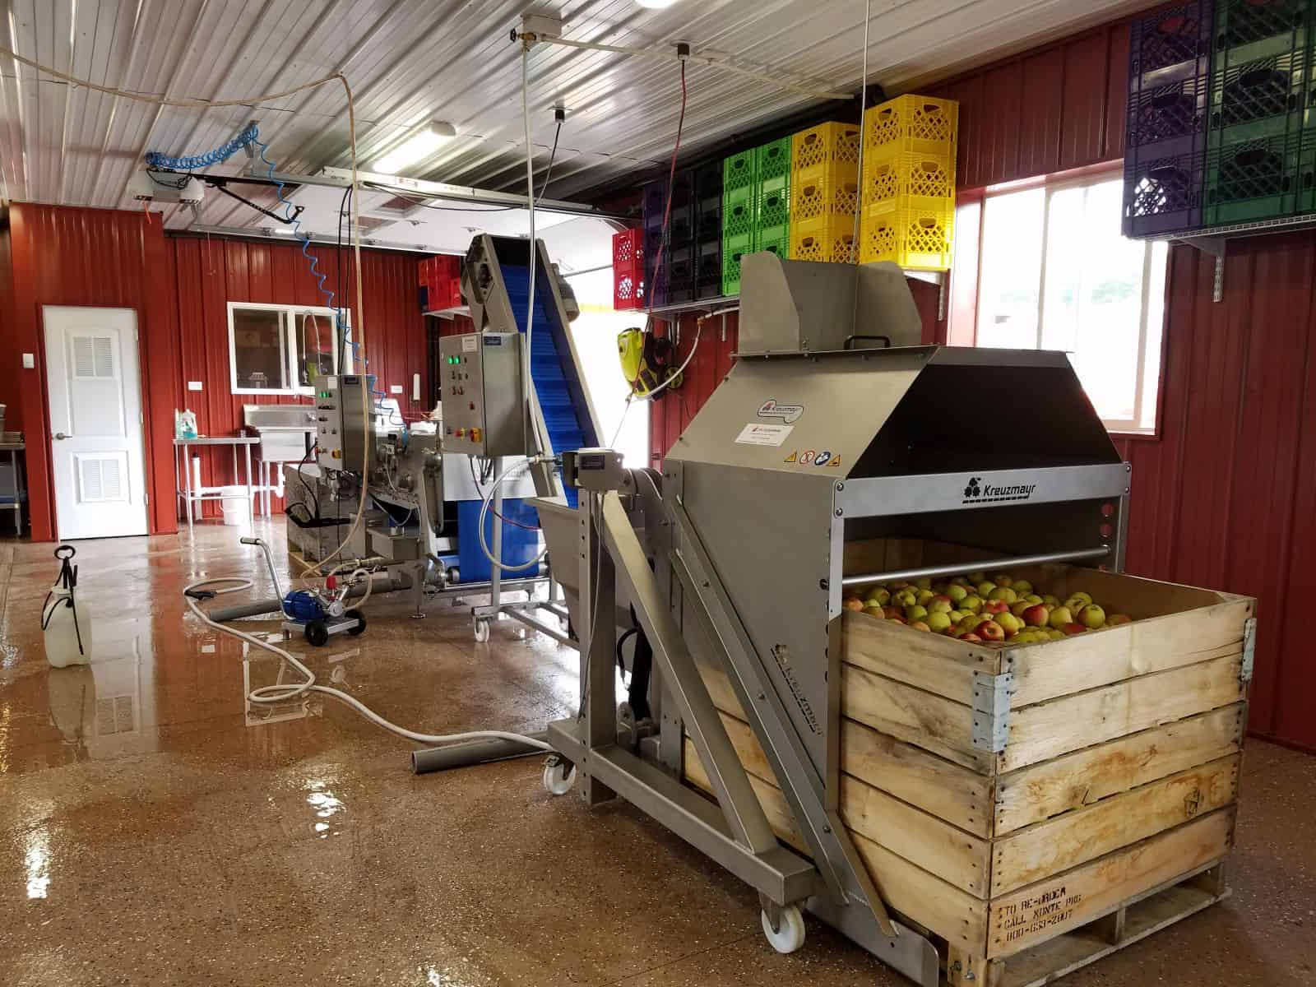
From Field to Shelf: Increasing Profits Through Season Extension and Diversification by Adding Value to Your Farm Products – Which Food Safety Principles Apply?
Amanda J. Kinchla Associate Extension Professor Food Science Department UMASS, Amherst
Kinchla@umass.edu
https://www.ciderculture.com/juicing-systems-cider-pressing-equipment-history/
Notes:
This presentation is filed at: https://umass.box.com/s/fkusllyf0d823zp1mmdhzvwcgzok2aha
Are you considering adding value to your farm products? Do you have questions about food safety regulations and what you must do? This program will describe some basic points of product development, food safety hazards, and an overview of key regulatory requirements, and is designed to provide a broad overview to meet the needs of small and emerging value-added farm businesses. Attendees will increase their knowledge in food safety principles to enable success in the marketplace. Topics include: Retail vs. wholesale; Residential vs commercial kitchens (and co-packing); Processed food regulations: Canning vs jelly/jam vs. juice vs others; Project supports and Q & A.

Slide 2
Click “View Options” and then annotate the next slide, you can use a stamp to show on the map where you are located!
Here is where you can turn on or off your camera and microphone
Click this ”Chat” button to ask a question during the presentation

Slide 3
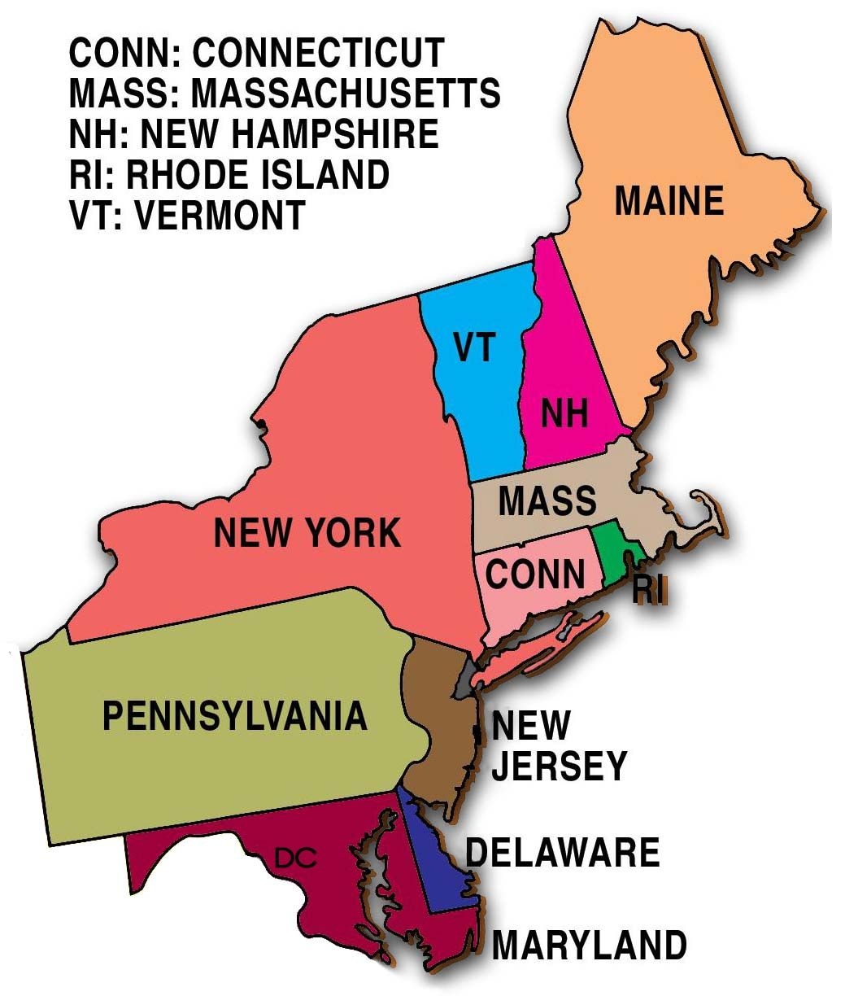
Other
Please use the “annotate” feature to mark where your facility is located on the map
Northeast States Labelling – Pinterest.com – Mrs. S’s Class

Slide 4
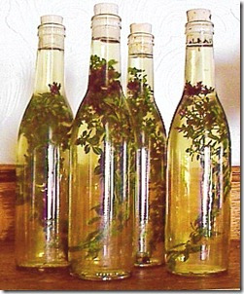
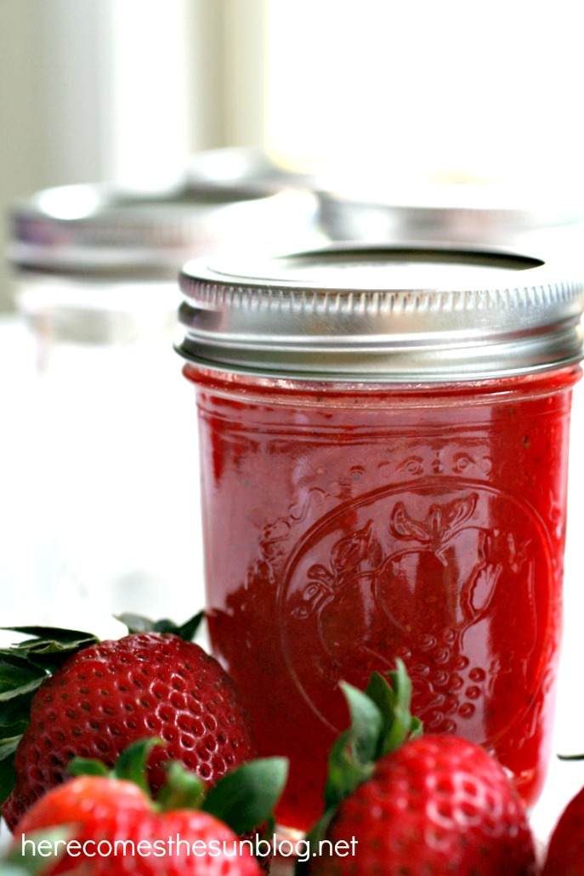
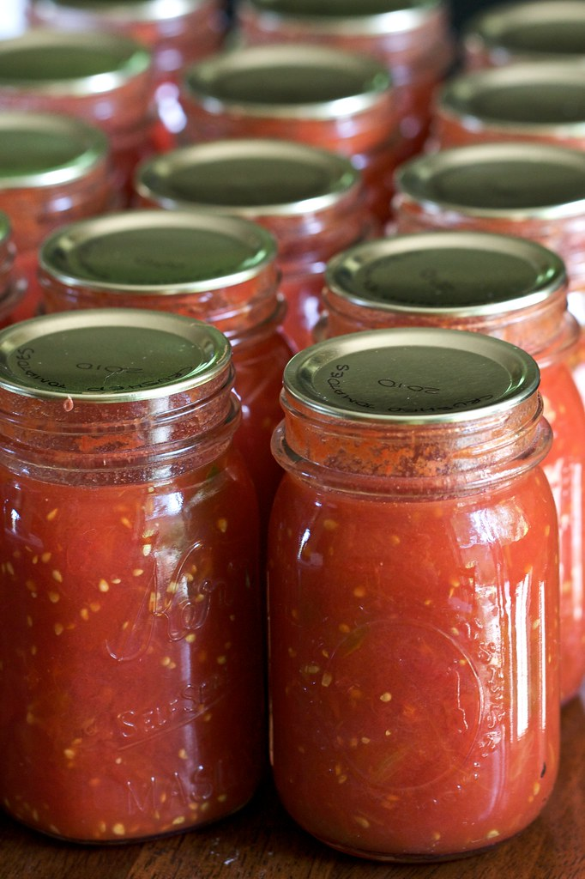
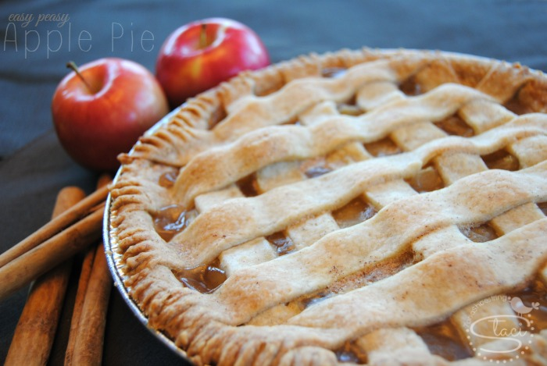
Why value-add?
Helps extend production season
Reduces waste
Surplus
Non-wholesale
Increases revenue
Introduces new markets
This Photo by Unknown Author is licensed under CC BY-NC-ND
This Photo by Unknown Author is licensed under CC BY-NC-ND
This Photo by Unknown Author is licensed under CC BY-NC-ND

Slide 5
Regulation: Retail vs. Wholesale
Retail
Wholesale
Restricted to sales directly to the consumer, and are inspected and licensed by the local board of health.
General consuming public (small portion)
Food Code - https://www.fda.gov/food/fda-food-code/state-retail-and-food-service-codes-and-regulations-state
Sold to wholesalers, retailers, and industrial or business purchasers (large quantity)
Wholesale operations may sell their products to retail stores, restaurants, etc., and are inspected and licensed by the Massachusetts Food Protection Program.
2 Regulating bodies
USDA – 9 CFR
FDA – 21 CFR
Notes:
https://www.concordma.gov/DocumentCenter/View/11785/Massachusetts-Residential-Kitchens-Brochure
https://foodsafetyprocessors.ces.ncsu.edu/wp-content/uploads/2018/01/FDA-versus-USDA.pdf?fwd=no

Slide 6
What Foods May Be Produced in A Residential Kitchen?
Retail Residential Kitchen - only “Cottage Food Products.”
Non-Potentially Hazardous –
Safely held at room temperature,
I.e. baked goods, jams, and jellies. 105 CMR 590.001(C); FC 1-201.10 (B)
Check your local boards of health regulations
Wholesale Residential Kitchen - produce foods that can be safely held at room temperature and foods that do not require refrigeration
Retail or Wholesale Residential Kitchens may not prepare finished products that require hot or cold holding for safety.
Examples Include: Meat, poultry, fish, juice, canned foods, cut produce, infused vinegars, sauces, prepared meals and more.
https://www.mass.gov/info-details/residential-kitchen-questions-and-answers#what-is-a-residential-kitchen?-

Slide 7
Can I make this in a residential kitchen?
This Photo by Unknown Author is licensed under CC BY
No. The preparation of frozen peas requires temperature control to ensure proper safety.

Slide 8
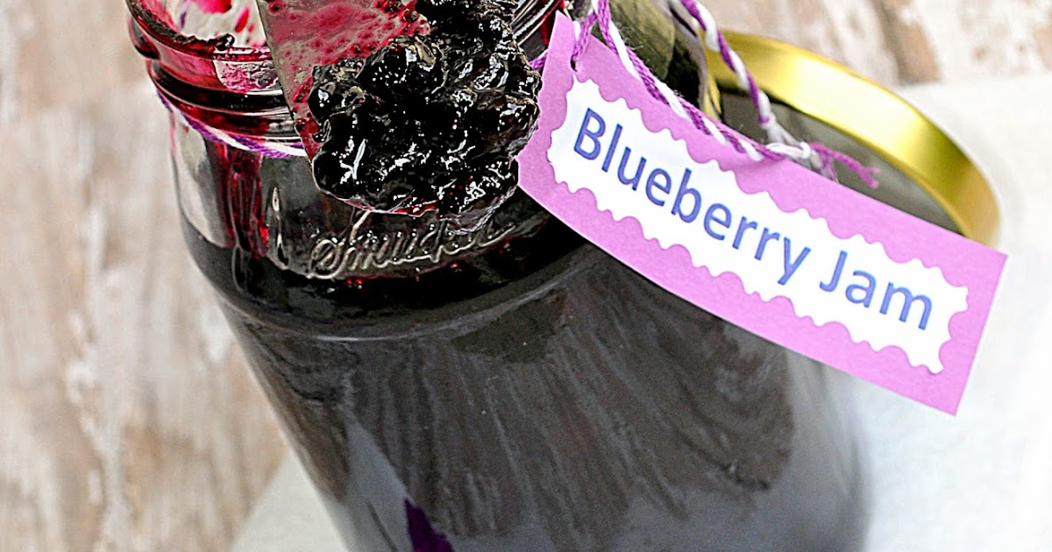
Can I make this in a residential kitchen?
This Photo by Unknown Author is licensed under CC BY-NC-ND
Yes! The natural sugars in the fruit plus added sugar and water bath canning help to make this product shelf stable. NOTE: Control Brix.

Slide 9
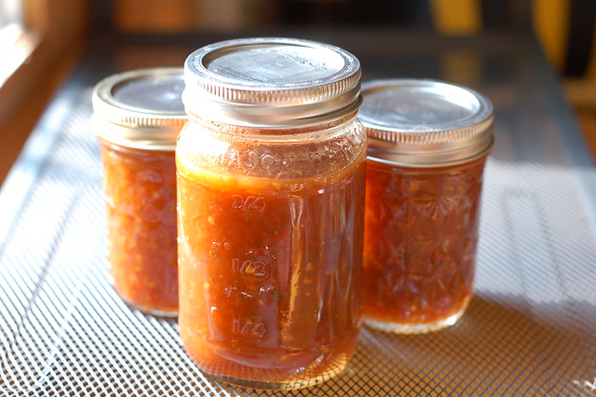
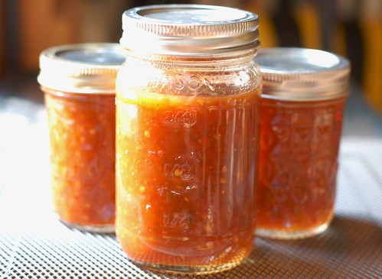
Can I make this in a residential kitchen?
This Photo by Unknown Author is licensed under CC BY-NC-ND
This Photo by Unknown Author is licensed under CC BY-NC-ND
No. The pH and processing conditions must be monitored to ensure food safety.
NOTE: Low acid and canned foods require a scheduled process issued by a process authority.

Slide 10
FSMA
Food Safety Modernization Act
Accredited
3rd Party Certification Rule 21 CFR Subpart M
Preventative Controls Human Food Rule and GMP 21 CFR 117
Produce Safety Standard Rule 21 CFR 112
Preventative Controls Animal Food 21 CFR 507
Foreign Supplier Verification Program Rule 21 CFR Subpart L
Intentional Adulteration (Food Defense) 21 CFR 121.1
Sanitary Transport Human & Animal Food 21 CFR Subpart O

Slide 11
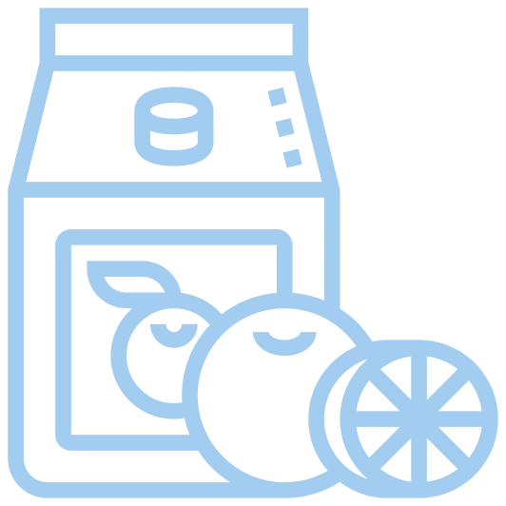
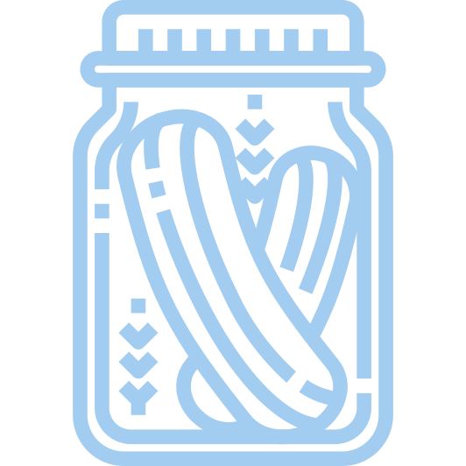
Food Safety Regulation and Processing
Food Safety
HACCP
Meat & poultry
9 CFR 304
Juice
21CFR 101/102
Low Acid
21CFR 113 AND Preventive Controls
Preventative
Controls
*Dairy – also PMO
*Acidified – also comply with 21CFR 114
Seafood
21CFR 123

Slide 12
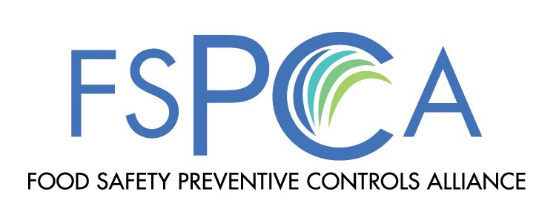
Preventive Controls: What are they?
Preventive Controls are procedures you implement to reduce or remove hazards that are found in your food product at your facility
There are four categories:
Process Preventive Control
Allergen Preventive Control
Sanitation Preventive Control
Supply chain Preventive Control

Slide 13
Contents of a Food Safety Plan
Required
Hazard analysis
Preventive controls*
Process, food allergen, sanitation, supply-chain and other
Recall plan*
Procedures for monitoring, corrective action and verification*
Useful
Facility overview and Food Safety Team
Product description
Flow diagram
Process description
Chapter 2, Food Safety Plan Overview for Preventive Controls for Human Food, slide 19
* Required when a hazard requiring a preventive control is identified

Slide 14
Hazard Analysis
The first step of creating a FSP is conducting a hazard analysis:
List Ingredient/processing steps
Identify potential food safety hazards
Determine if hazard requires a PC
Justify Decision
Identify preventive controls for significant hazard
Double check preventive control has been implemented

Slide 15
Potential Preventive Controls Examples
Biological Hazards
Process controls that kill pathogens
E.g. Cooking
Process controls that prevent growth; e.g.
Time/temperature controls
Checking formulation
Supply-chain programs for sensitive ingredients used without a kill step
Sanitation Controls that prevent recontamination
Chemical Hazards
Supply-chain programs
Allergen Labeling
Sanitation controls to prevent allergen cross-contact
Physical Hazards
Process Controls such as
Filtering, metal detection, X-ray devices

Slide 16
Hazard Analysis Example
Hazard Analysis |  | PRODUCT: |  | PAGE X of Y
PLANT NAME |  |  | ISSUE DATE | mm/dd/yy
ADDRESS |  |  | SUPERSEDES | mm/dd/yy
Prepared Frozen Omelet
Joe’s Famous Breakfasts Facility
1000 Main St, Amherst MA USA
(1) Ingredient/ Processing Step | (2) Identify potential food safety hazards introduced, controlled or enhanced at this step |  | (3) Do any potential food safety hazards require a preventive control? |  | (4) Justify your decision for column 3 | (5) What preventive control measure(s) can be applied to significantly minimize or prevent the food safety hazard? Process including CCPs, Allergen, Sanitation, Supply-chain, other preventive control | (6) Is the preventive control applied at this step?
 |  |  | Yes | No |  |  | Yes | No
 | B
 | C
 | P
Biological Hazards
Chemical Hazards
Physical Hazards
FSPCA – Hazard Analysis and Preventive Controls Determination for Human Food

Slide 17
Hazard Analysis | Prepared Frozen Omelet |  | PAGE X of Y
PLANT NAME | Joe’s Famous Breakfasts Facility | ISSUE DATE | mm/dd/yy
ADDRESS | 1000 Main St, Amherst MA USA | SUPERSEDES | mm/dd/yy
(1) Ingredient/ Processing Step | (2) Identify potential food safety hazards introduced, controlled or enhanced at this step |  | (3) Do any potential food safety hazards require a preventive control? |  | (4) Justify your decision for column 3 | (5) What preventive control measure(s) can be applied to significantly minimize or prevent the food safety hazard? Process including CCPs, Allergen, Sanitation, Supply-chain, other preventive control | (6) Is the preventive control applied at this step?
 |  |  | Yes | No |  |  | Yes | No
Receiving refrigerated ingredients – liquid pasteurized egg | B | Vegetative pathogens such as Salmonella | X |  | While pasteurization minimizes the likelihood of Salmonella USDA recommends the product be used in cooked foods. Experience has shown Salmonella occasionally occurs in this ingredient. | Process Control - subsequent cook step |  | X
 | C | Allergen – egg, | X |  | Egg is an allergen that must be labeled to inform consumers. Cross-contact is not an issue – all products contain egg. | Allergen Control – allergen labeling at other steps |  | X
 | P | None |  | X
FSPCA – Hazard Analysis and Preventive Controls Determination for Human Food

Slide 18
Modified Requirements
Read this article to check if you fall under the qualified individual category:
Guidance for Industry: Determination of Status as a Qualified Facility
Where to find attestation forms online – FDA Website
Having a food safety plan is relevant! You want to assure that risks in the facility are being addressed properly.
https://www.fda.gov/food/registration-food-facilities-and-other-submissions/qualified-facility-attestation
18

Slide 19
GMPs
Current Good Manufacturing Practices 21 CFR Part 117
Personnel
Plant and grounds
Sanitary operations
Sanitary facilities and control
Equipment and utensils
Processes and controls
Warehousing and distribution
Holding/distribution of human byproducts for animal use
Natural or unavoidable defects that present no health hazard
22http://www.fpsa.org/wp-content/uploads/CFR-110-vs-117.pdf
https://www.centurylabel.com/news/2016/9/8/cmc-groups-century-label-division-achieves-gmp-certification

Slide 20
Legal & Financial Implications - Recalls
Recalls are actions taken to remove an adulterated, misbranded, or violative product from the market.
If there is a hazard in your facility or with your product, you MUST have a recall plan!
Your liability
Your customers
Your reputation
The local food system

Slide 21
Record Keeping
Records used to document that food safety hazards have been controlled by preventive controls
Accurate record keeping provides documentation that food safety hazards are being controlled.
Information required:
Standard information required
Signature or initials of the person reviewing the record, and date of the review
Cost and risk considerations

Slide 22
Food Safety Recommendations: Where Do I Start?
Implement/Develop/Maintain GMPs
Set up a documentation system for critical control points in your operating procedures (SOPs)
Develop written ingredient and packaging material specifications developed for all suppliers, and verification of compliance with those suppliers.
Sanitation Controls – recommended cleaning products to be used during manufacturing
Audit – will provide recommendations for improvement*

Slide 23
Key Points for Preventive Controls
FSMA - “Directs the Food and Drug Administration (FDA) as the food regulatory agency of the U.S. Department of Health and Human Services to better protect public health by, among other things, adopting a modern, preventive, and risk-based approach to food safety regulation.”
Preventive controls fall under FSMA
Should have plan by January 2020 if you’re a qualified facility
If your product falls under the modified qualifications, understand and file for attestation
If your product falls under the modified qualifications, understand and file for attestation

Slide 24
Key Points for Preventive Controls
Key core components of FSP/Preventive Controls
Hazard Analysis
Preventive Controls*
Monitoring
Corrective Actions
Verifications and Associated Records
Developing a food safety plan will help you and your staff understand the risks and significantly reduce food-related incidents.

Slide 25
Personnel
Consultants and auditors
Process authorities and subject matter experts
University specialists
Government agencies
Trade associations
Suppliers, buyers, laboratory analysts

Slide 26
Trusted Internet Sites and FDA Guidance
FSPCA, FDA Website, Trade Association Websites, USDA Website
In Development: Food Safety Preventive Controls for Human Food Hazards and Controls Guidance*
Seafood HACCP Hazards and Controls Guidance
Juice HACCP Hazards and Controls Guidance

Slide 27
Helpful Reminders
Don’t be alone in making your food safety plan!
Say what you do, do what you say
Hazards are okay!
Your safety plan is dynamic
Make a commitment to ensure food safety

Slide 28
Amanda J. Kinchla Associate Extension Professor Food Science Department Kinchla@umass.edu
Thank you!
Successful Value Added Food Product Development: Managing Food Quality and Safety, March 23, 25 & 30th from 9AM-1PM:
MDAR Food Entrepreneur Guide – coming this spring!
Resource leads for NPD: https://ag.umass.edu/food-science/resources

